Slide 1
9th International Conference on Computing, Communication, Control and Automation (ICCUBEA-2025)
Pimpri Chinchwad Education Trust’s
Pimpri Chinchwad College of Engineering, Pune
Presentation By:
PAPER ID - 490
PAPER TITLE - An Automated Real time Image Driven Quality Control : A vision-based Solution for Industrial Object Classification
Author Name –Nagesh A. Patil, Ms Nutan V. Bansode, Sonali Sawant, Sumit Kumar,
Aryan Kumar, Amir Furquani
MIT Academy Of Engineering , Alandi , Pune

Slide 2
Outline
Introduction
Problem Statement
Objectives
Literature Review
Methodology
Results
Conclusion
References

Slide 3
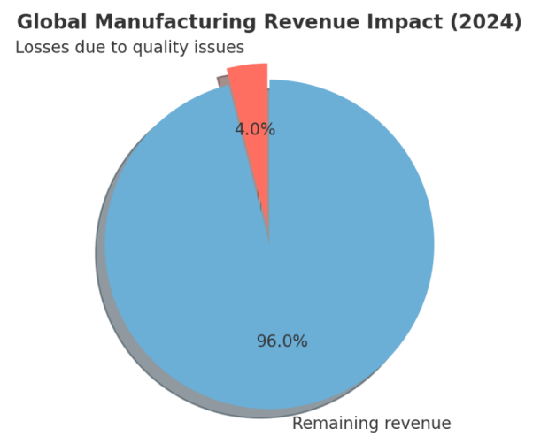

Introduction
Current Market Scenario
Global manufacturing market size (2024): ~USD 14 trillion
Quality-related losses cost industries 3–5% of revenue annually
Current Classification methodology
Six Sigma & ISO compliance
Manual and Automated method for Quality Control (QC)
QC is mandatory for Competitiveness & Profitability
Increasing demand for real-time, zero-error inspection

Slide 4
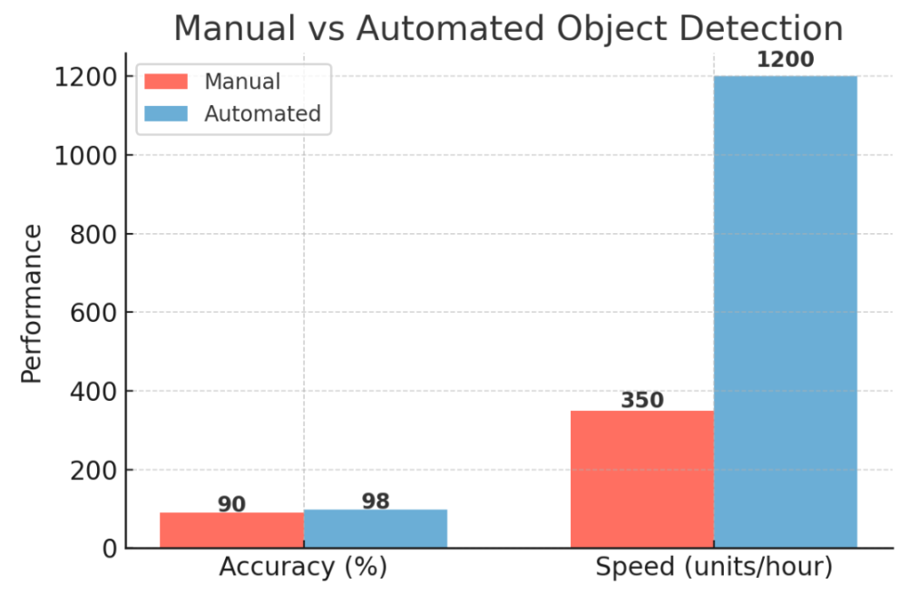
Problem Statement
Major Industry Crisis:
Takata Air Scandal- $24B with bankruptcy for faulty manufacturing.
Mattel's Toy Recall Crisis- 21M toys recalled with the cost of $300M
Nestle- Maggie Noodles
Current Challenges
Present Inspection Limitations:
Error rate ~5–10%
Slower throughput
High cost in rework & returns
Market Pressure:
Demand for faster delivery & mass customization
Impact on Industry: Losses in production, logistics, and customer satisfaction

Slide 5
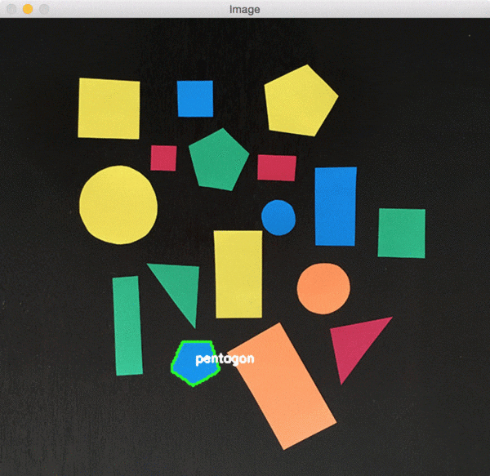
Proposed Solutions
Object detection drives inspection, quality, and automation.
A key challenge is precise object size measurement
Goal is to achieve precise object measurements with computer vision for object detection and recognition.

Slide 6






Objectives
Gathering industrial dataset to train & test for accuracy.
To detect the geometric shape of the object
To detect physical dimension of the Object.
To identify and classify the color of the object based on standardized color datasets
To develop an interactive graphical user interface (GUI) using Flask and React for effective user interaction

Slide 7

Literature Survey

Slide 8
Ref No. |  | Title | Year | Key Focus | Methodology
1 | Wicaksono, M. F., and M. D. Rahmatya | 3D Geometric Shape and Colors Interactive Learning Media using Raspberry Pi, OpenCV, and TensorFlow Lite | 2023 | Interactive learning, Raspberry Pi, OpenCV, TensorFlow Lite | 3D geometric modeling using Raspberry Pi, OpenCV, TensorFlow Lite
2 | Joy, Deborah T., et al. | Computer vision for color detection | 2021 | Color detection, computer vision | Computer vision-based color detection algorithms
3 | Othman, Nashwan Adnan, et al. | An embedded real-time object detection and measurement of its size | 2018 | Embedded system, object detection, size measurement | Embedded real-time system with object detection & size estimation

Slide 9
Ref No. |  | Title | Year | Key Focus | Methodology
4 | Song, Jiqiang, Min Cai, and Michael R. Lyu | Edge color distribution transform: an efficient tool for object detection in images | 2002 | Edge color distribution, efficient object detection | Edge color distribution transform for image analysis
5 | Liu, Guang-Hai, and Jing-Yu Yang | Exploiting color volume and color difference for salient region detection | 2018 | Salient region detection, color features | Salient region detection exploiting color volume and differences
6 | Abdellatif, Mohamed | Effect of color pre-processing on color-based object detection | 2008 | Color pre-processing, object detection | Color pre-processing techniques for object detection

Slide 10
Ref No. |  | Title | Year | Key Focus | Methodology
7 | Karanam, Madhavi, et al. | Object and its dimension detection in real time | 2023 | Real-time dimension detection | using vision-based methods
8 | Ankad, Sushma S., et al. | Object Size Measurement from CCTV footage using deep learning | 2021 | Deep learning, CCTV, size measurement | CCTV-based object size measurement
9 | Datta, Shreyasi, et al. | Object shape and size recognition from tactile images | 2013 | Tactile images, shape and size recognition | Tactile sensing + shape/size recognition algorithms
10 | Basavaraj, M. U., and H. Raghuram | Real Time Object Distance and Dimension Measurement using Deep Learning and OpenCV | 2023 | Real-time distance and dimension measurement, Deep Learning, OpenCV | Deep learning & OpenCV for distance and dimension measurement

Slide 11
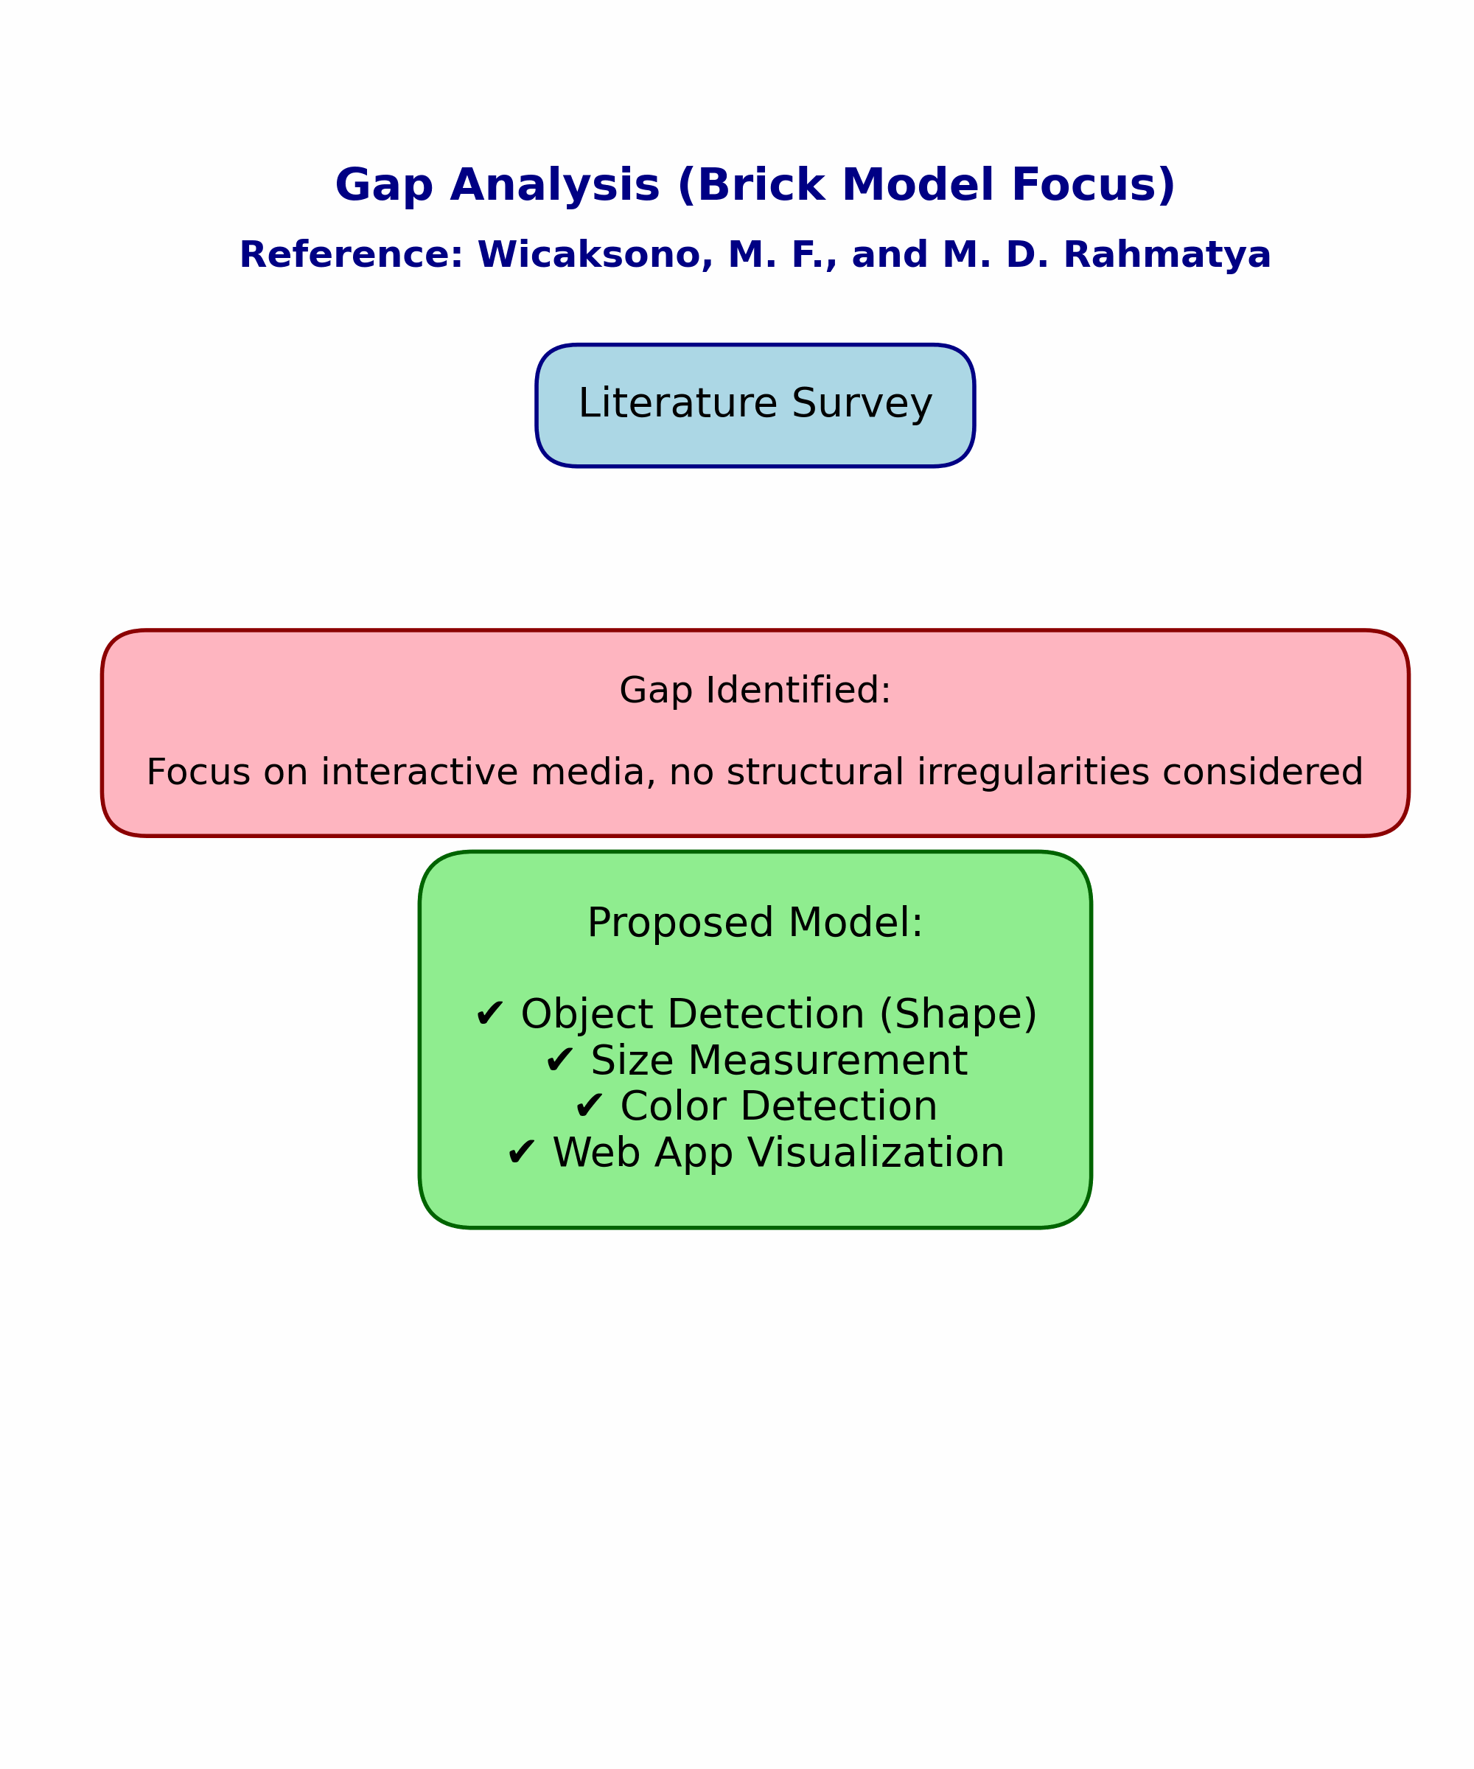

Slide 12









System Used
Software
Programming Language
Python
Libraries
OpenCV, PIL, rembg
Web Framework
Flask and React
Visual Studio Code
Hardware
Standard CPU(Stand alone system)

Slide 13
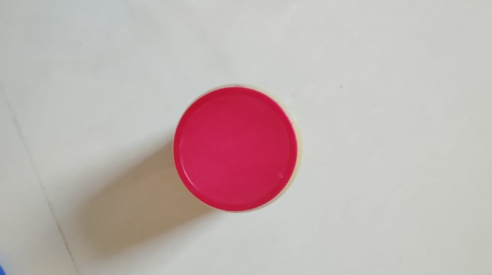
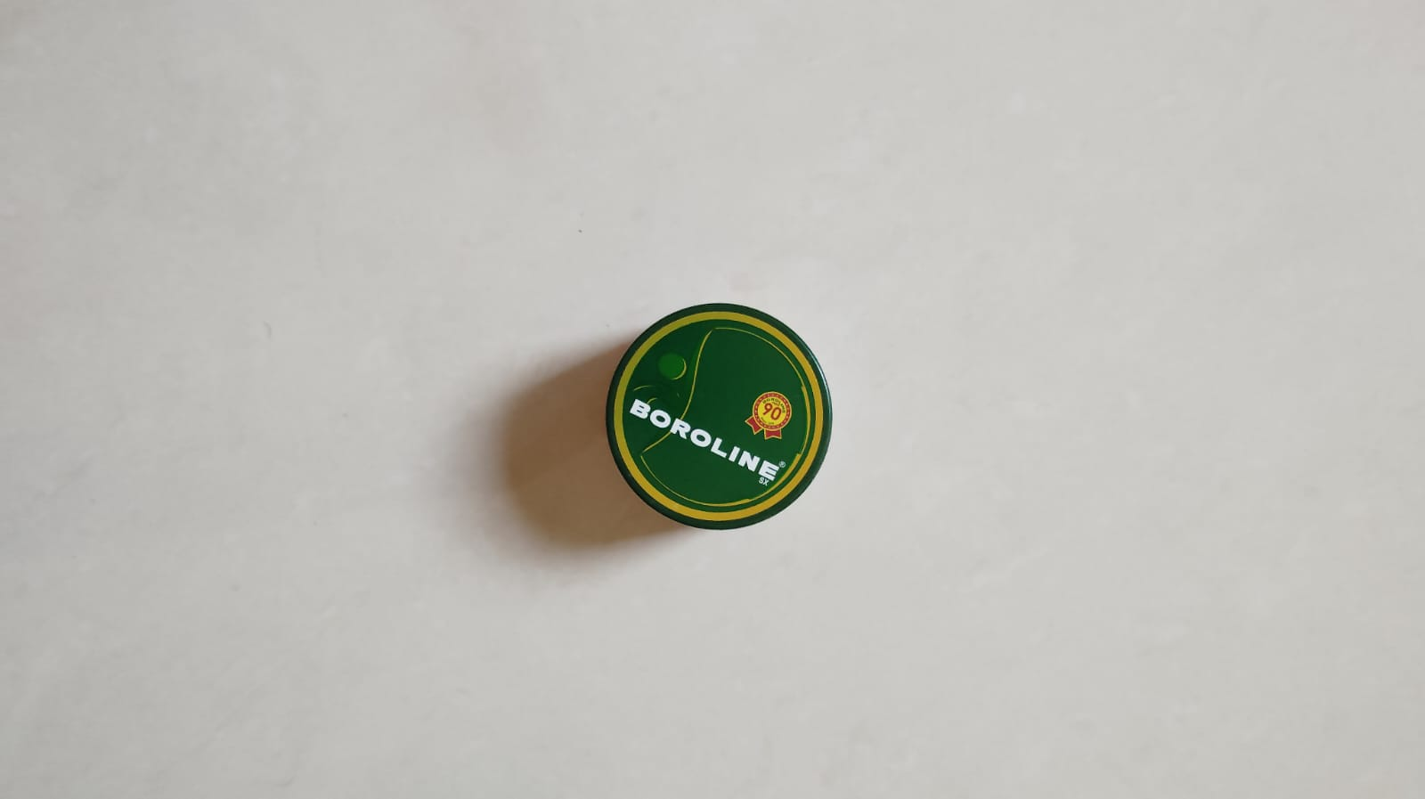
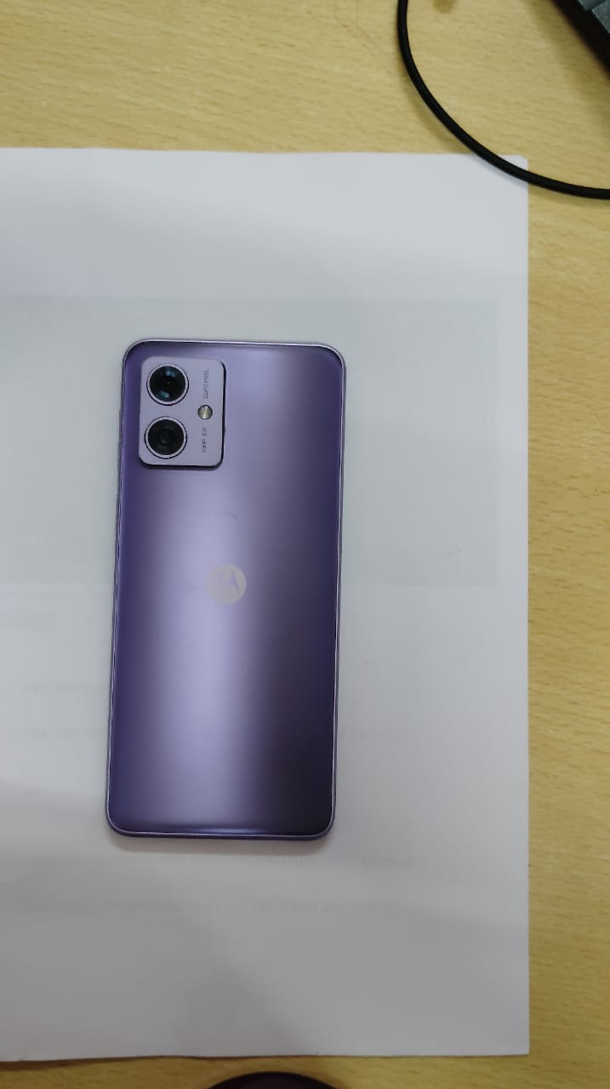
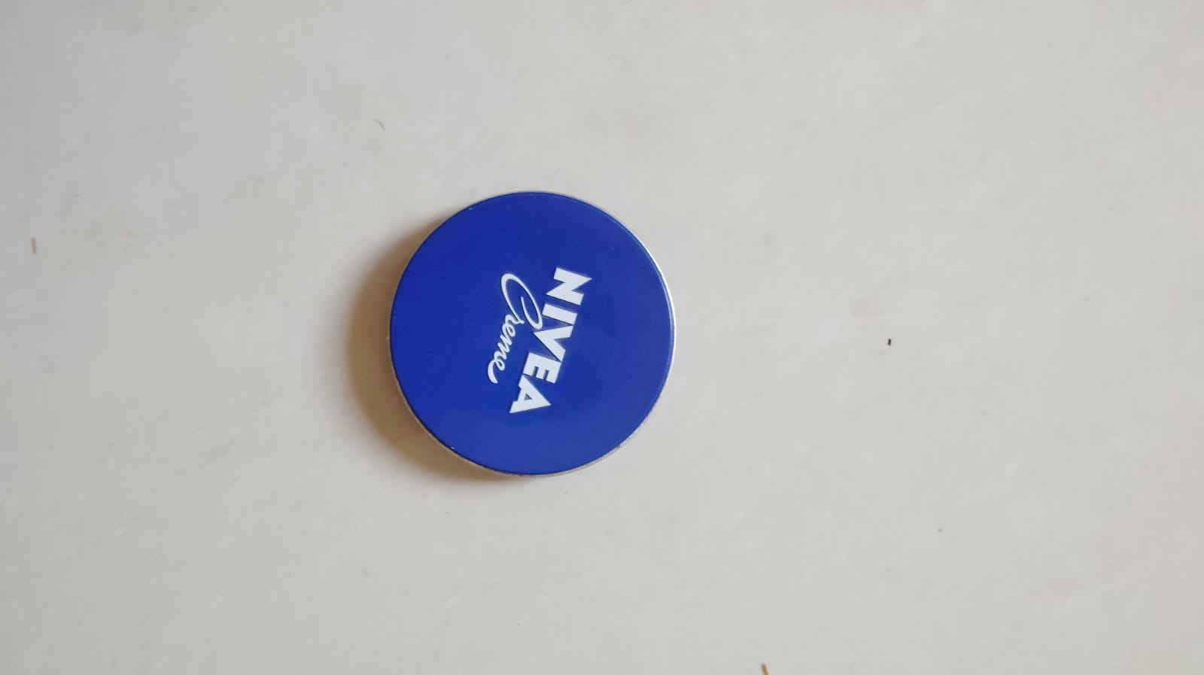
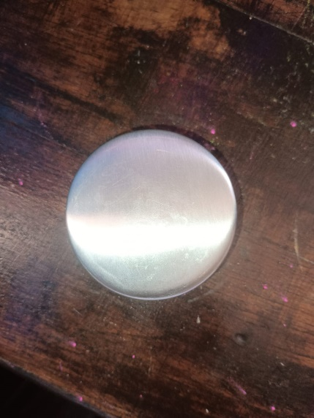
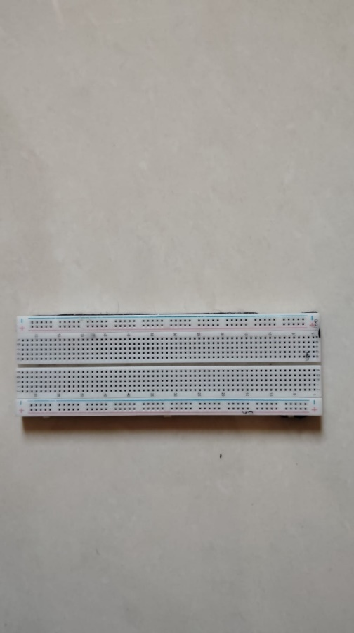
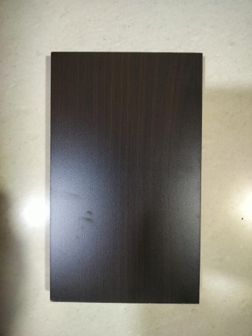
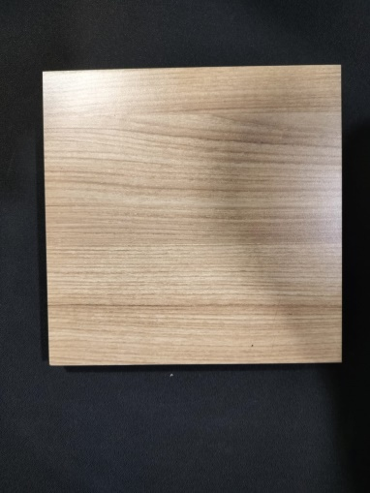
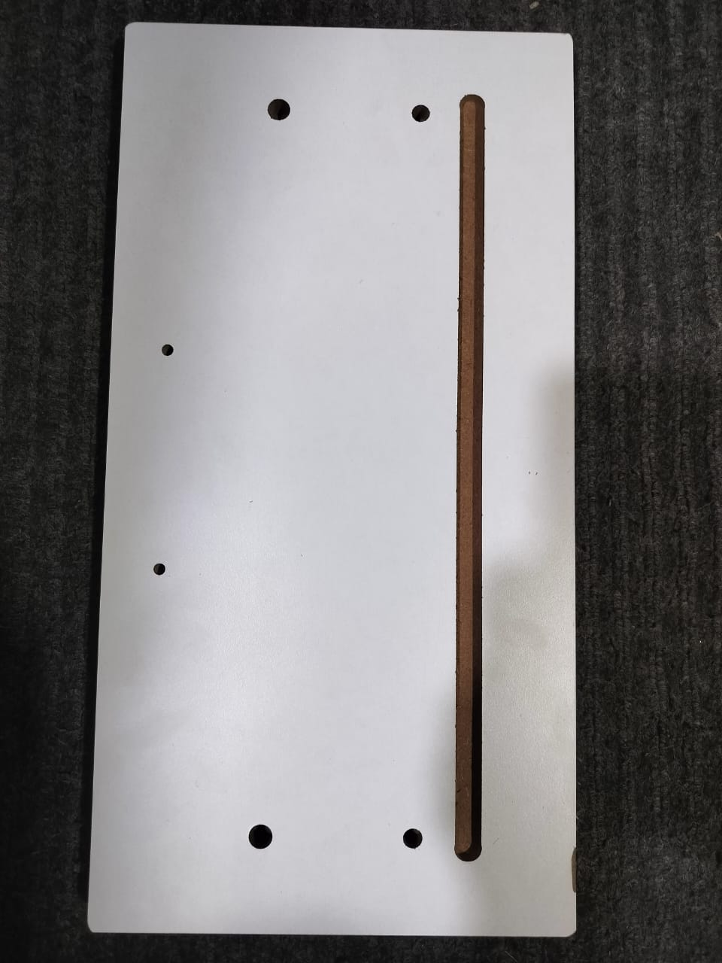
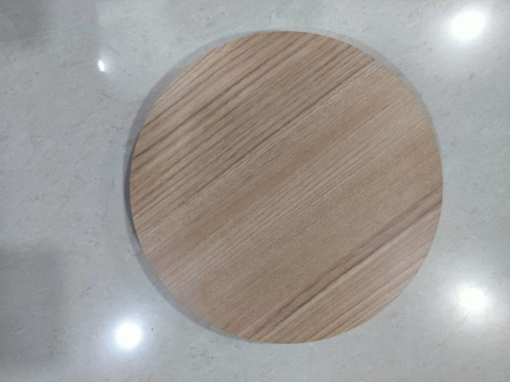
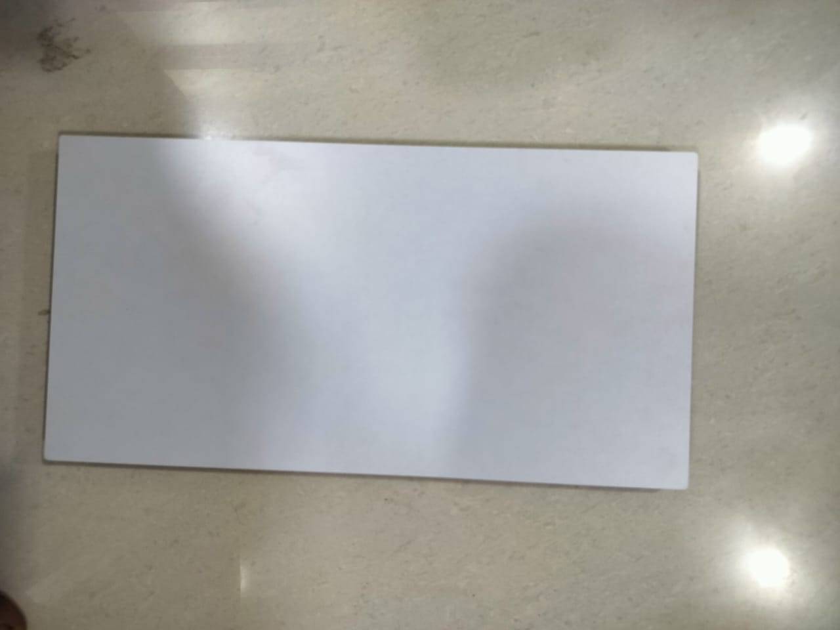
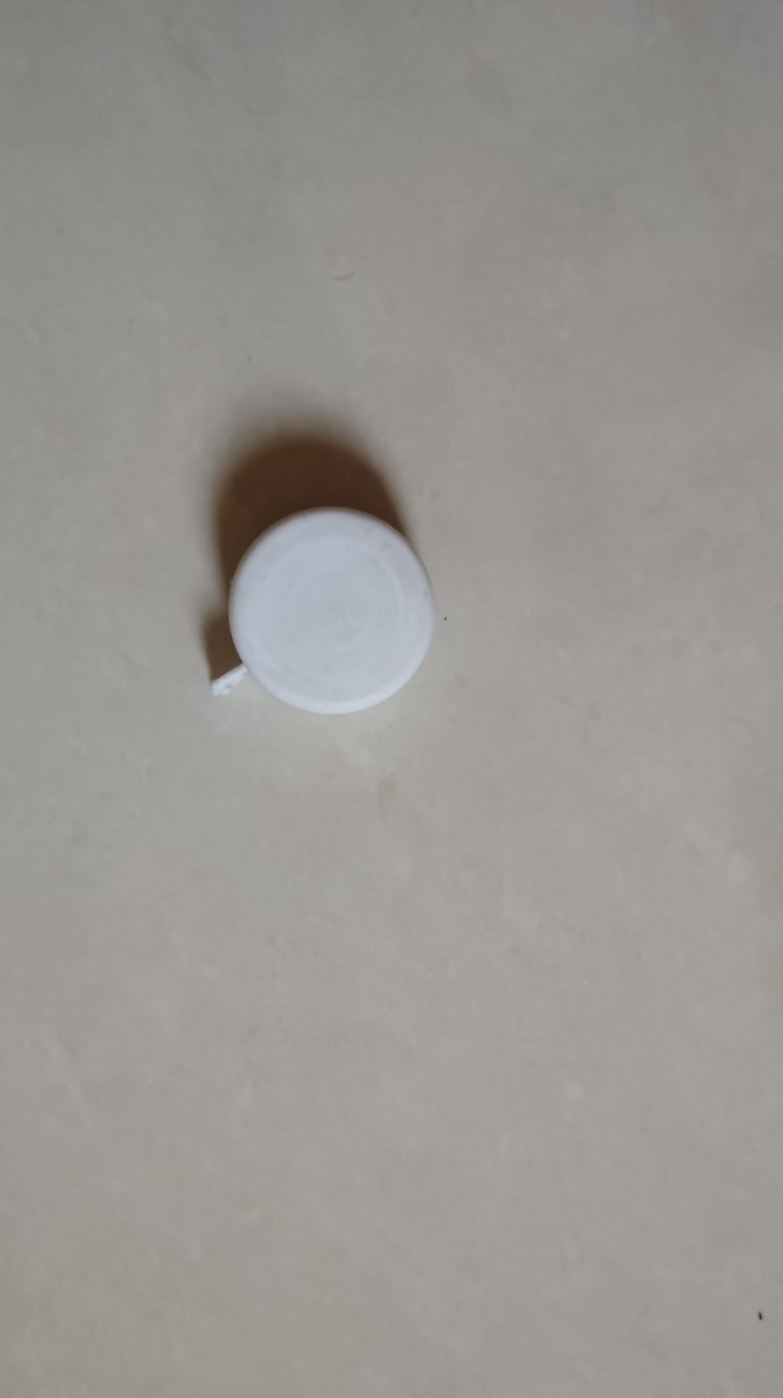
Input Database

Slide 14
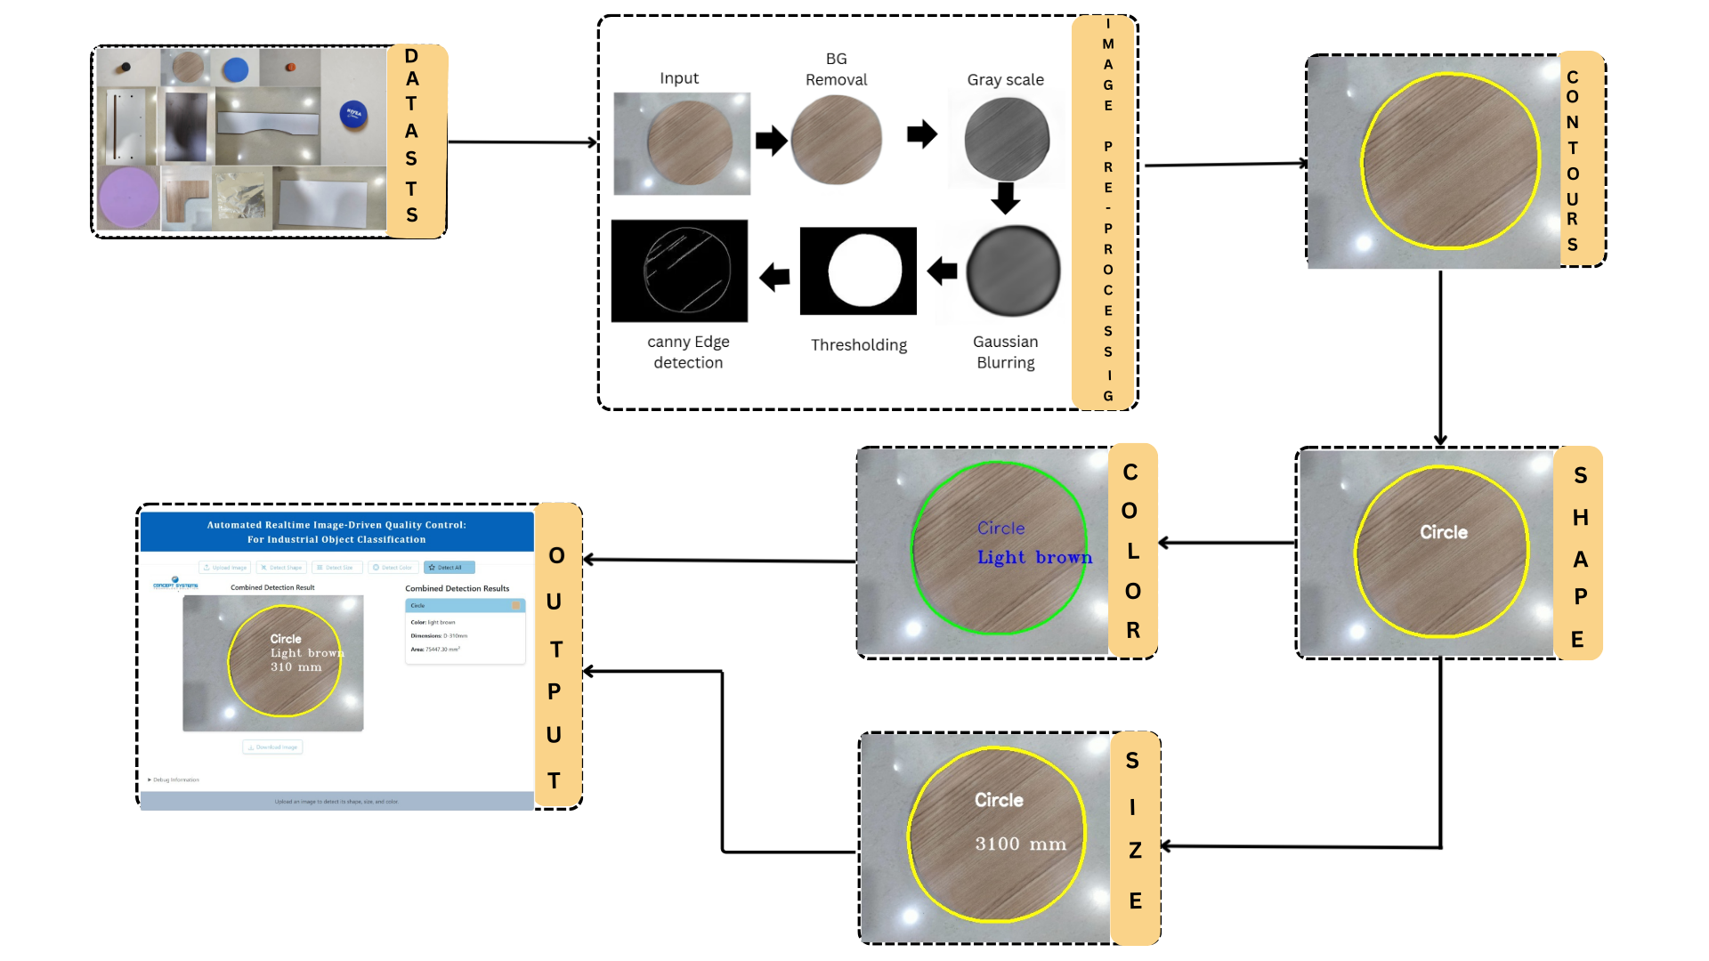
Methodology
Fig:- Graphical abstract of the Proposed system

Slide 15
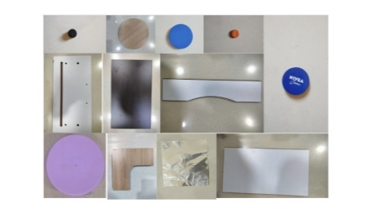
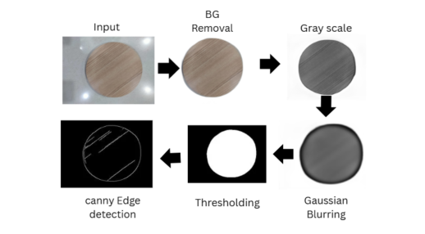
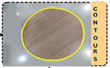
Layered Assessment Model
<Step I>
Input Image
Different type of objects images captured from around 2 to 10 fits of distance
<Step II>
Image Pre-processing
B G removal
Gary scale conversion
Gaussian Blur
Thresholding
Manual
<Step III>
Contour Detection
Retrieve External
Chain Approx Simple
Aimed at improvement and self-correction
Declaration
Model validated from research to industry
<Step -IV>
Object detection
Shape, Color, Size detection
Certifies achievement at the end of the project
Automated

Slide 16
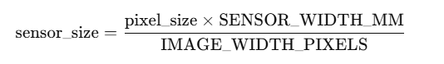
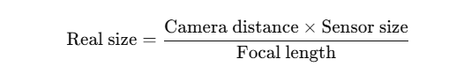
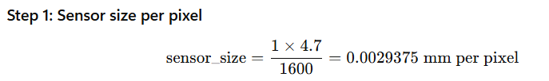
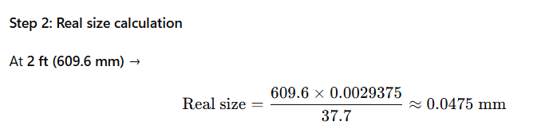
Mathematical Formulation
Case: Image taken from n feet
IMAGE PIXELS WIDTH = 1600 mm
SENSOR WIDTH = 4.7mm
FOCAL LENGTH = 37.7 mm
So, in real At 2 ft, each pixel ≈ 0.047 mm

Slide 17
Object Size Accuracy: Actual vs Predicted
Sr. No | Object name and shape | Size AD (cm2) | Size PD (cm2) | Color | Accuracy (%)
1 | Wooden Rectangle 1 | 60x30 | 59.09x28.87 | Dim gray | 94.85
2 | Wooden Circle | 33.5 | 31 | Light brown | 92.60
3 | Wooden Rectangle 2 | 60x30 | 61.37x31.22 | Alice blue | 93.54
4 | Wooden Rectangle 3 | 65x25 | 63.54x23.40 | Alice blue | 91.52
5 | Wooden Square | 28x28 | 28.58x29.31 | Light brown | 93.14
6 | Perfume Cap | 4.5 | 4.66 | Black | 96.57
7 | Bottle Cap | 4.5 | 4.75 | Snow | 94.61
8 | Breadboard | 16.5x5 | 16.93x5.19 | Mid cream | 93.49
9 | Nivea Cream | 7 | 6.80 | Indigo | 97.27
10 | Boroline | 5.5 | 5.23 | Dark green | 95.21
Notes:
Why is accuracy changing?

Slide 18
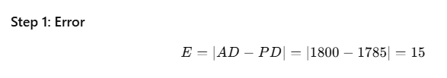
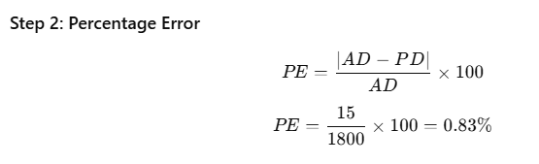
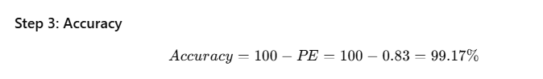
Mathematical Formulation
Case: Wooden Rectangle 1
Error = 15 cm²
Percentage Error = 0.83 %
Accuracy = 99.17 %

Slide 19
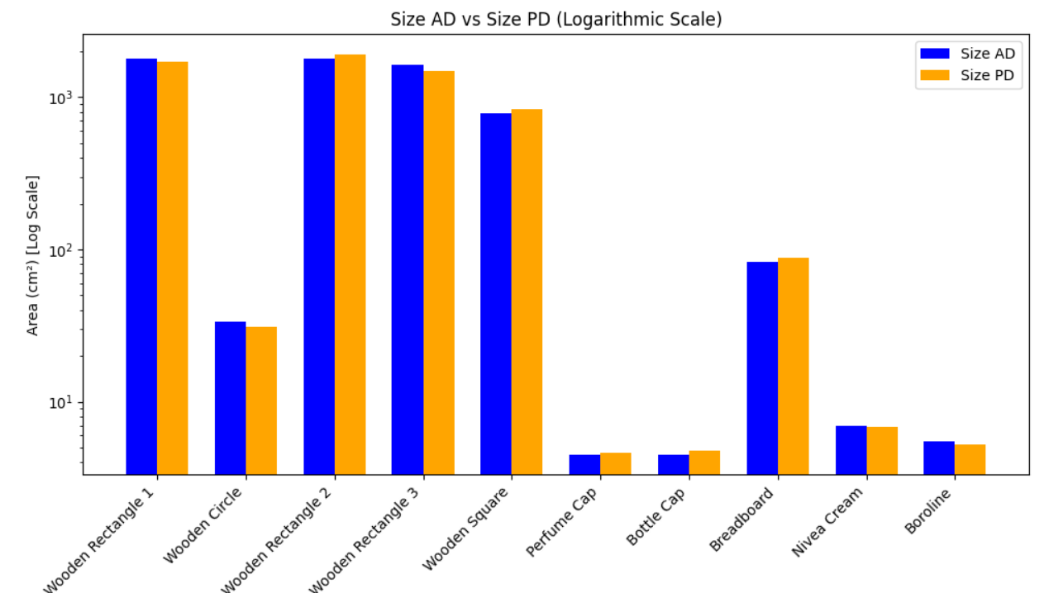
Result Graph
Fig:- Graph showing bar plot between Ad and PD

Slide 20
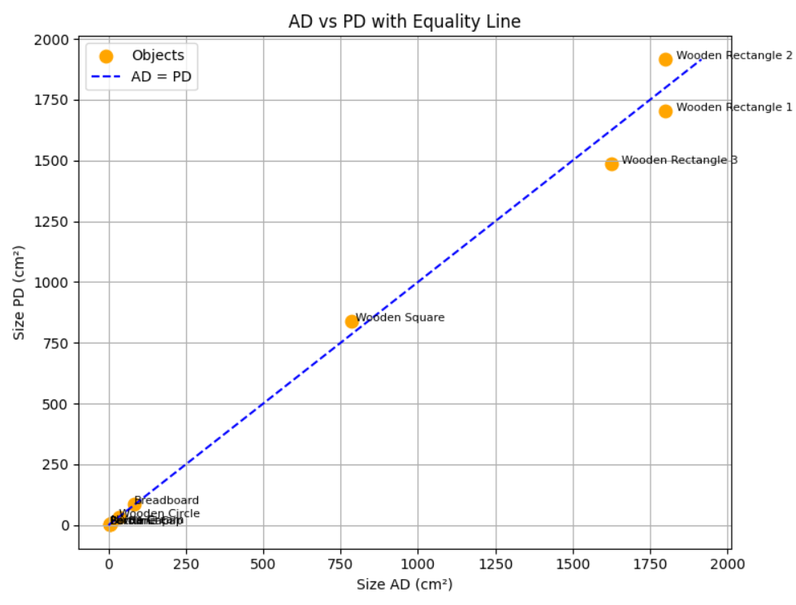
Comparison of Actual (AD) vs Predicted (PD) Object Sizes
The equality line (AD = PD) indicates perfect agreement.
Points close to the line show accurate predictions, while deviations (mostly overestimations) are observed for larger objects
Fig:- Graph Showing Equality line with AD and PD

Slide 21
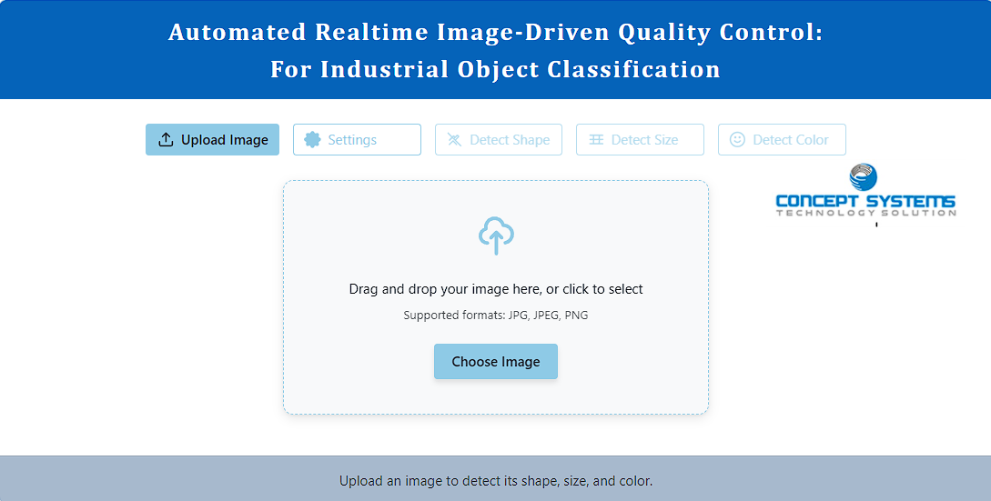
RESULTS
Main Interface

Slide 22
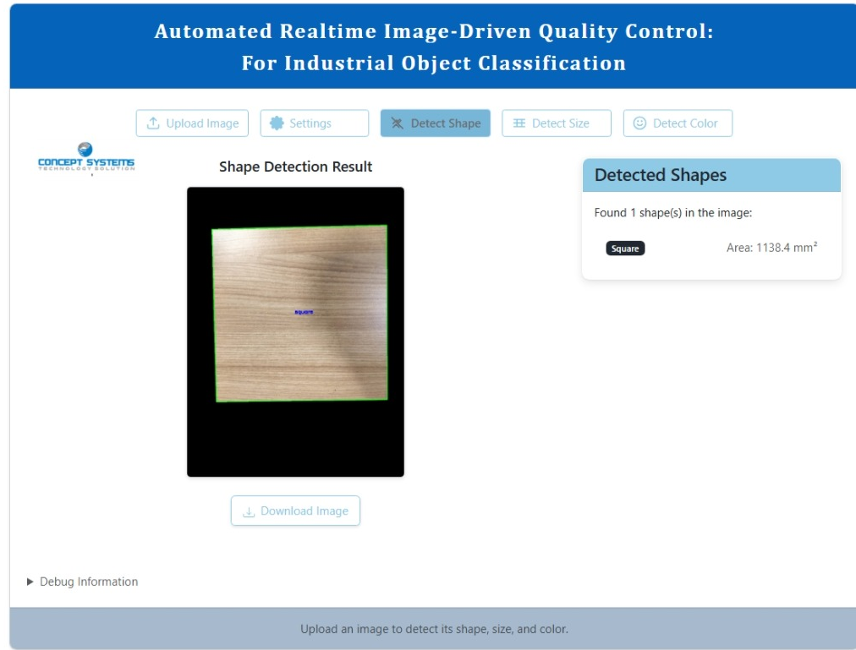
RESULTS
Shape Detection

Slide 23
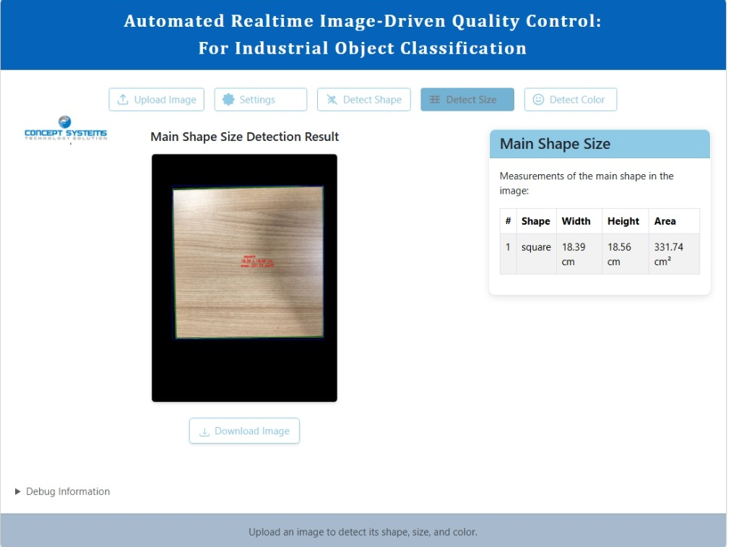
RESULTS
Size detection

Slide 24
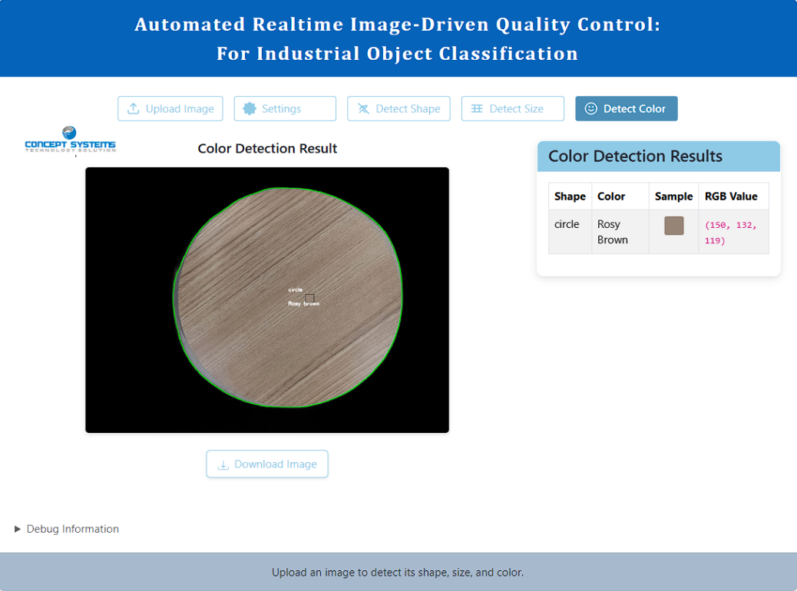
RESULTS
Color Detection

Slide 25
Conclusion
The proposed system offers a reliable, contactless solution for detecting defects in industrial objects by accurately identifying their shape, size, and color using image processing techniques with OpenCV.
Achieving an accuracy of 94.34%, the system minimizes human involvement and eliminates the need for additional hardware, making it both cost-effective and scalable.
By integrating the algorithm into a Flask-based application, the approach provides an Integrated platform suitable for real-time or offline industrial quality inspection.
This method enables timely defect detection, allowing industries to take corrective action at the right stage and maintain high-quality standards 24/7.

Slide 26
Future work
Integrating deep learning for surface defect detection.
Expanding dataset with complex industrial parts.
Testing on high-speed conveyor belt environments

Slide 27
References
Wicaksono, M. F., and M. D. Rahmatya. "3D Geometric Shape and Colors Interactive Learning Media using Raspberry Pi, OpenCV, and TensorFlow Lite." International Journal on Advanced Science, Engineering & Information Technology 13.5 (2023).
Joy, Deborah T., et al. "Computer vision for color detection." Int. J. Innov. Res. Comput. Sci. Technol 9.3 (2021): 53-59.
Othman, Nashwan Adnan, et al. "An embedded real-time object detection and measurement of its size." 2018 International Conference on Artificial Intelligence and Data Processing (IDAP). IEEE, 2018.
Song, Jiqiang, Min Cai, and Michael R. Lyu. "Edge color distribution transform: an efficient tool for object detection in images." 2002 International Conference on Pattern Recognition. Vol. 1. IEEE, 2002.
Liu, Guang-Hai, and Jing-Yu Yang. "Exploiting color volume and color difference for salient region detection." IEEE Transactions on Image Processing 28.1 (2018): 6-16.

Slide 28
References
Abdellatif, Mohamed. "Effect of color pre-processing on color-based object detection." 2008 SICE Annual Conference. IEEE, 2008.
Karanam, Madhavi, et al. "Object and it’s dimension detection in real time." E3S Web of Conferences. Vol. 391. EDP Sciences, 2023.
Ankad, Sushma S., et al. "Object Size Measurement from CCTV footage using deep learning." 2021 IEEE International Conference on Computation System and Information Technology for Sustainable Solutions (CSITSS). IEEE, 2021.
Datta, Shreyasi, et al. "Object shape and size recognition from tactile images." 2013 International Conference on Control Communication and Computing (ICCC). IEEE, 2013.
Basavaraj, M. U., and H. Raghuram. "Real Time Object Distance and Dimension Measurement using Deep Learning and OpenCV." 2023 Third International Conference on Artificial Intelligence and Smart Energy (ICAIS). IEEE, 2023.

Slide 29
THANK YOU
Any Questions?

